Slide 1


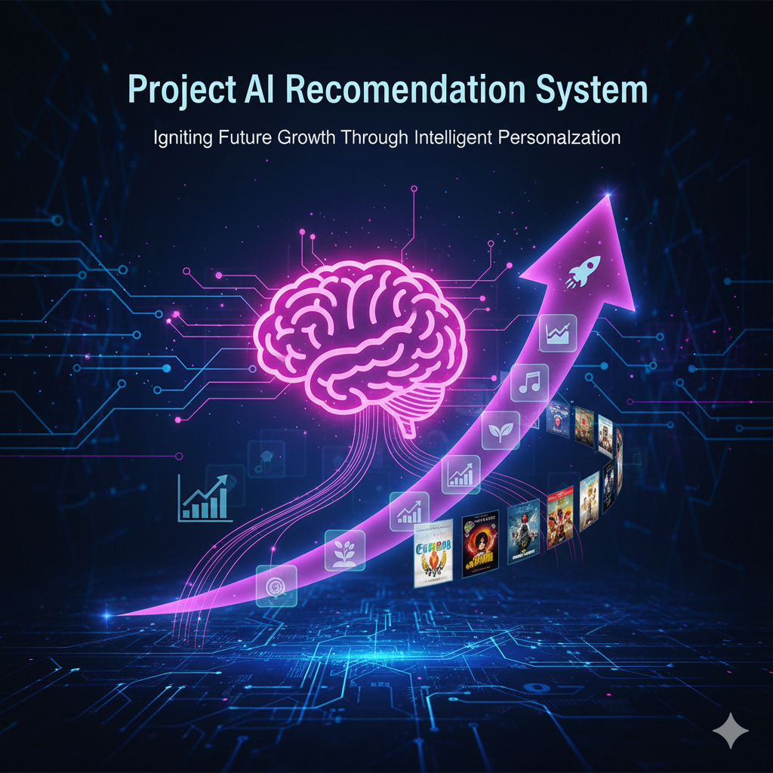
EchoReel: A Content-Based Movie Recommendation System 🎬
By: Sneha Kumari (IITRPRAI_24081716) Course: Minor in Artificial Intelligence, IIT Ropar Track: Artificial Intelligence

Slide 2

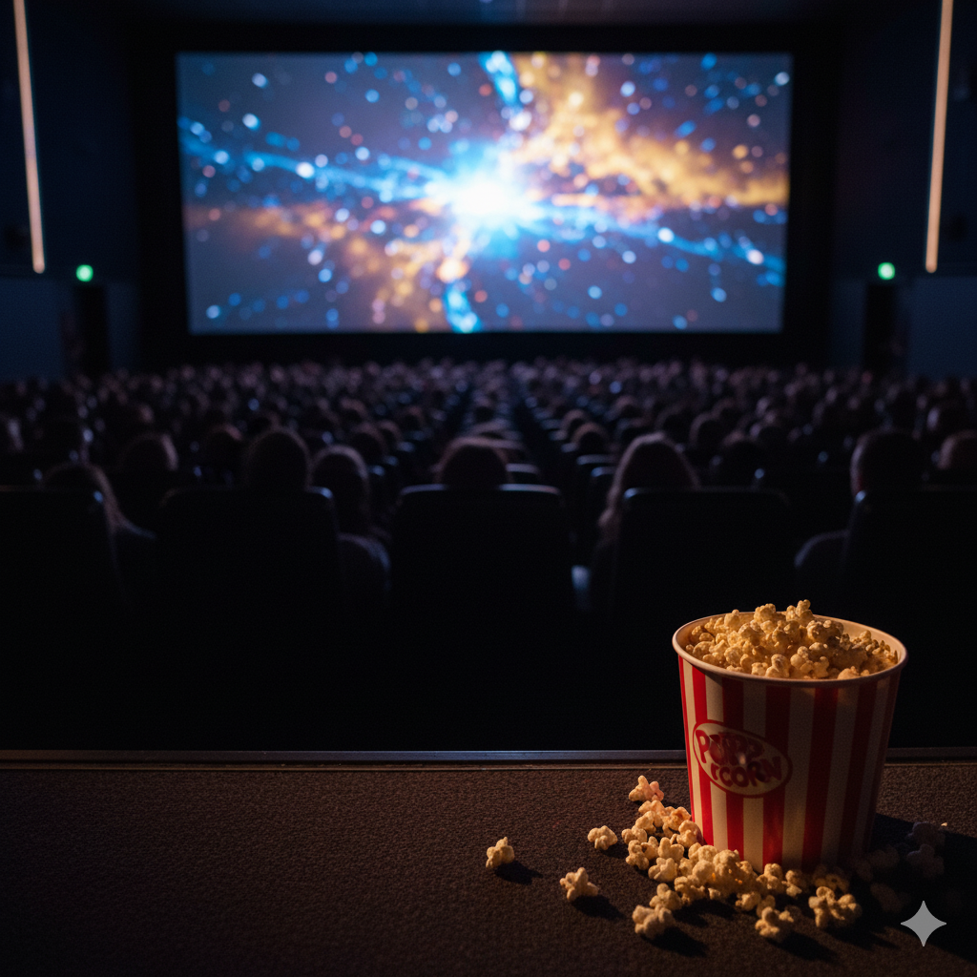
Introduction
In today’s world of streaming platforms, viewers face content overload.
It becomes challenging to decide what to watch next.
EchoReel aims to make this easier by using Machine Learning to recommend movies similar to your favorites.
This system learns movie features and similarities — not popularity — to generate meaningful suggestions.

Slide 3

🌍 The Modern Entertainment Dilemma
In today’s streaming-driven era, users face an overwhelming number of choices — thousands of movies, limited time, and constant indecision.
Key Challenges:
🎥 10,000+ movies released globally each year. 🔎 Users spend an average of 20+ minutes daily just deciding what to watch. 💡 OTT fatigue is real — personalization is now a necessity, not a luxury.
EchoReel addresses this challenge by offering intelligent, data-driven movie recommendations that truly align with the user’s taste.

Slide 4
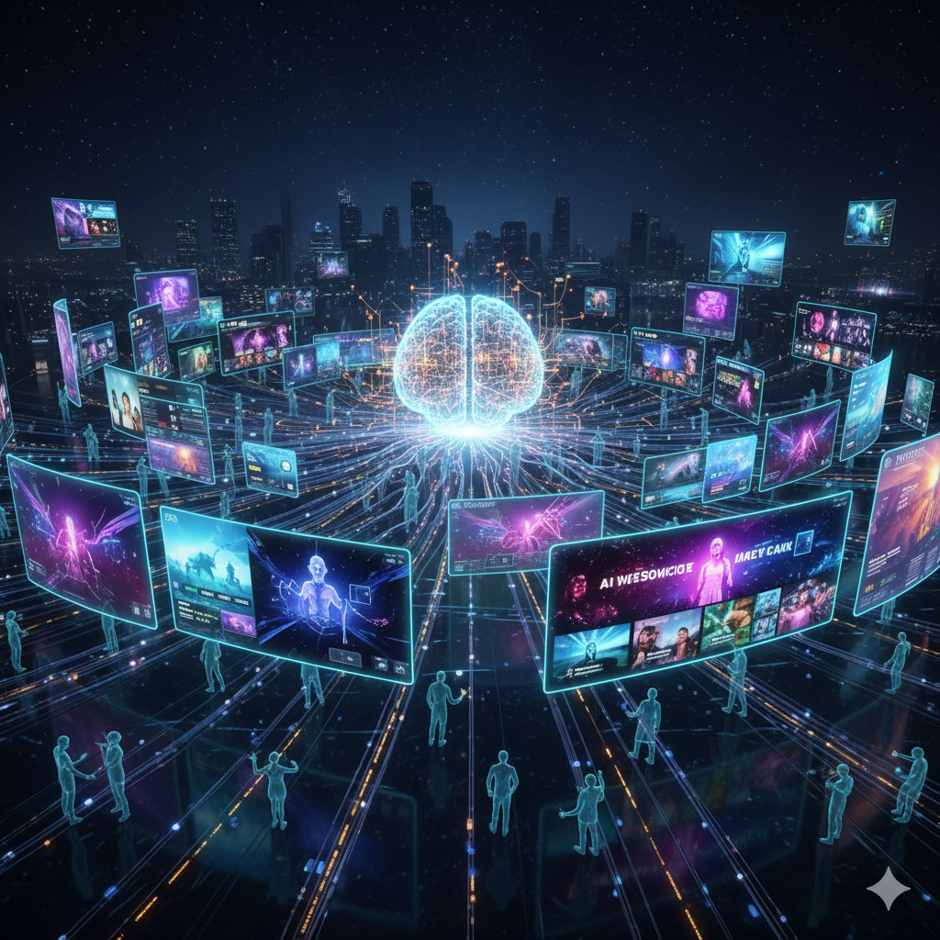
🧠 The AI Revolution in Movie Discovery
Movie discovery has evolved from simple genre filters to context-aware AI models. EchoReel represents the next step — combining machine learning and NLP for story-level understanding.
Evolution Timeline:
Rule-Based Filters: Basic genre/year/actor sorting. Collaborative Filtering: “Users who liked X also liked Y.” Content-Based Filtering (EchoReel): Analyzes movie plots, cast, and crew to find meaningful similarities. Deep Learning Future: Transformer-based embeddings (e.g., BERT) for semantic understanding.

Slide 5

🔍 How EchoReel Works
EchoReel uses Natural Language Processing (NLP) and Cosine Similarity to understand each movie’s narrative DNA and recommend contextually similar titles.
Pipeline Overview:
Data Source: Movies dataset fetched from Kaggle: ML-Based-Movies-Recommender/dataset/tmdb_5000_credits.csv and tmdb_5000_movies.csv Preprocessing: Extracts overview, genres, cast, keywords, and crew data Feature Engineering: Merges all text features into a unified “tags” column Vectorization: Converts text data into numerical form using CountVectorizer Similarity Computation: Uses Cosine Similarity to find the closest movies in vector space Poster Retrieval & Output: Top 5–10 recommendations displayed via Streamlit, with posters fetched using the OMDB API

Slide 6
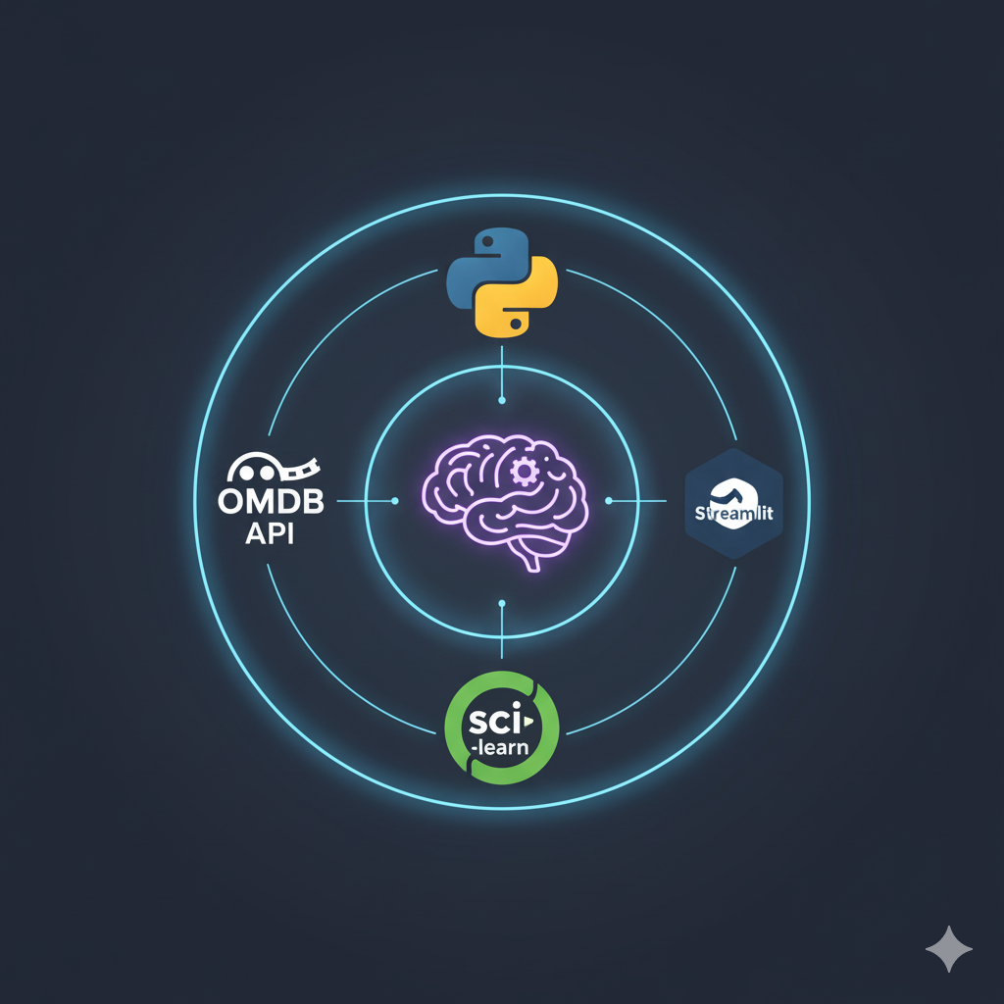
⚙️ Technology Stack
Component | Technology Used
Programming Language | Python
Libraries | Pandas, NumPy, Scikit-learn, NLTK
Dataset | Kaggle: tmdb_5000_credits.csv & tmdb_5000_movies.csv
API | OMDB API (for movie posters)
ML Techniques | CountVectorizer, Cosine Similarity
Deployment | Streamlit
Model Saving | Pickle serialization

Slide 7
Implementation Process and System Architecture
Stage 1: Data Ingestion → Loading and merging CSVs
Stage 2: Data Validation → Removing null & duplicate entries
Stage 3: Data Transformation → Generating tags, vectorization
Stage 4: Model Training → Computing cosine similarity matrix
Stage 5: Deployment → Building and running Streamlit app
User Input (Movie Title)
↓
Data Preprocessing & Tag Generation
↓
Vectorization using CountVectorizer
↓
Cosine Similarity Computation
↓
Top 5 Similar Movies + Poster Display
↓
Streamlit UI Output

Slide 8
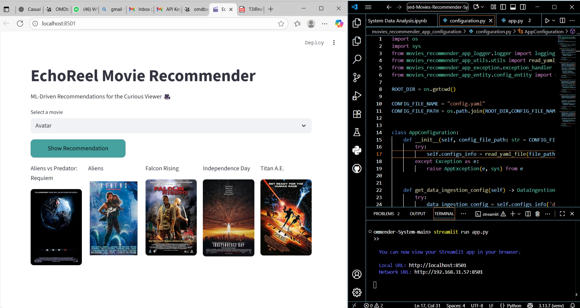
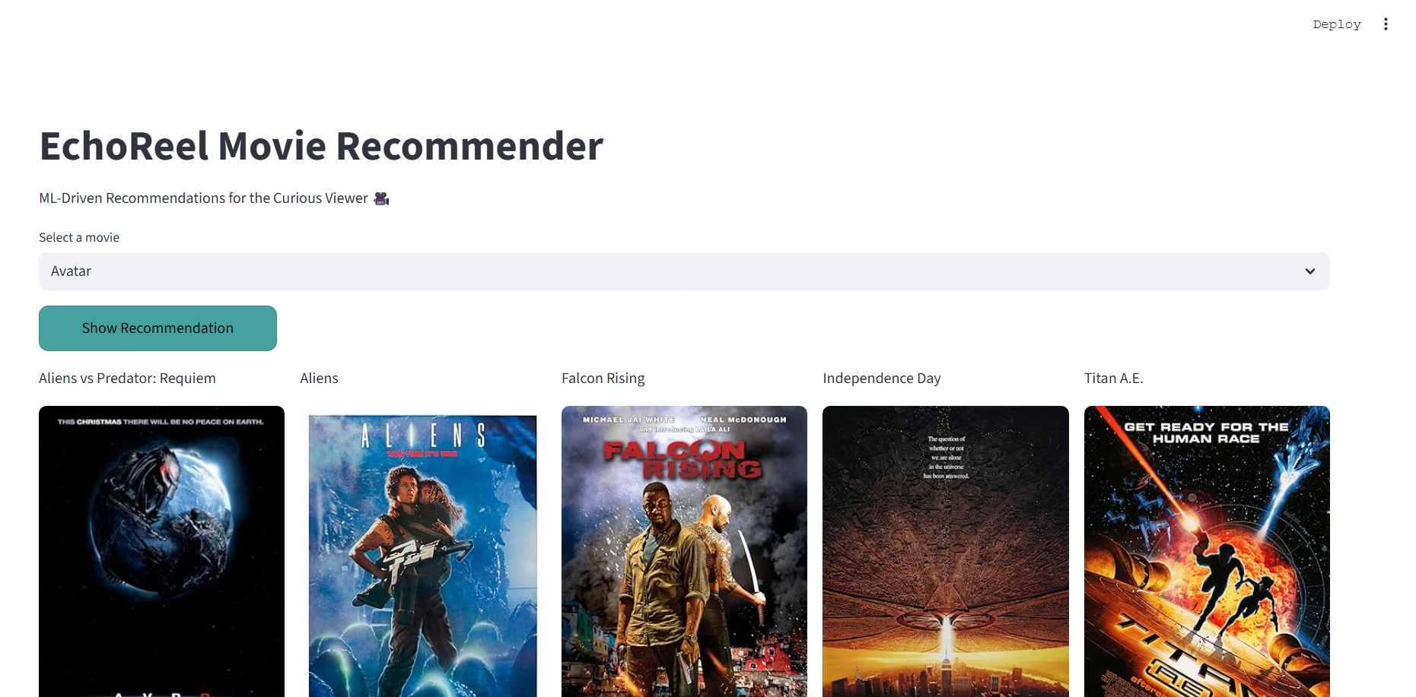
Application Interface (Demo)

Slide 9
🎯 Evaluation Metrics
Metric | Purpose | Result
Precision@10 | Measures relevance among top 10 recommendations | 0.50
Recall | Fraction of relevant movies retrieved | 1.00
F1-Score | Balances precision and recall | 0.67
Cosine Similarity Score | Measures vector-level closeness between movies | Most values 0.6–1.0; high intra-movie similarity on diagonal; clusters indicate thematic/genre grouping

Slide 10
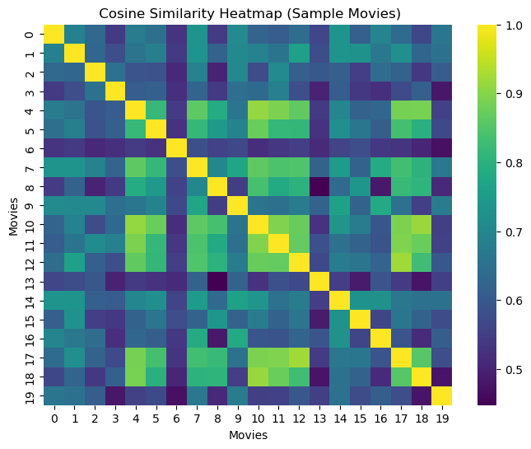
Heatmap of similarity scores
High intra-movie similarity: Diagonal shows perfect self-similarity
Clusters of similar movies: Bright patches indicate thematic/genre-based grouping
Low similarity zones: Dark areas indicate distinct content/features
Range-bound similarity: Most values between 0.6 and 1.0, indicating moderate-to-strong relationships

Slide 11
🏆 Results & Observations
User Input: 🎞 Avatar (2009) EchoReel Output: ➡ Aliens vs Predator: Reqiem ➡ Falcon Rising ➡ Aliens ➡ Independence Day ➡ Titan A.E.
✨ Each recommendation shares sci-fi, action, and futuristic storytelling themes, showing how EchoReel captures narrative and stylistic context.
✅ Fast similarity computation due to precomputed vectors ✅ Consistently relevant recommendations across genres ✅ Real-time poster fetching enhances engagement ✅ Streamlit UI provides clean and intuitive experience

Slide 12
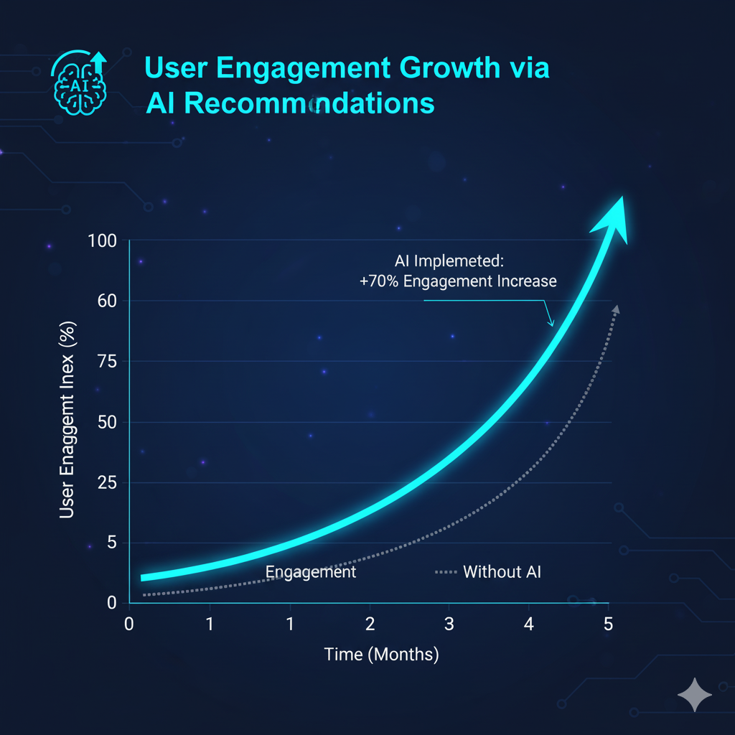
🌟 Industry Impact
AI-powered recommendation systems are reshaping entertainment worldwide:
🎬 OTT Platforms: 80% of Netflix views originate from AI recommendations 📈 User Engagement: Personalized AI suggestions increase retention by 35% 💡 Market Growth: Global recommendation engine market projected to reach $17B by 2028 🌏 Scalability: EchoReel’s OMDB-based model can adapt to multiple languages and content ecosystems

Slide 13

🧩 Ethics & Data Responsibility
EchoReel emphasizes ethical, transparent, and privacy-respecting AI design:
No personal data collection — content-based only
Avoids user bias by not depending on ratings or demographics
Transparent similarity logic and explainable recommendations

Slide 14
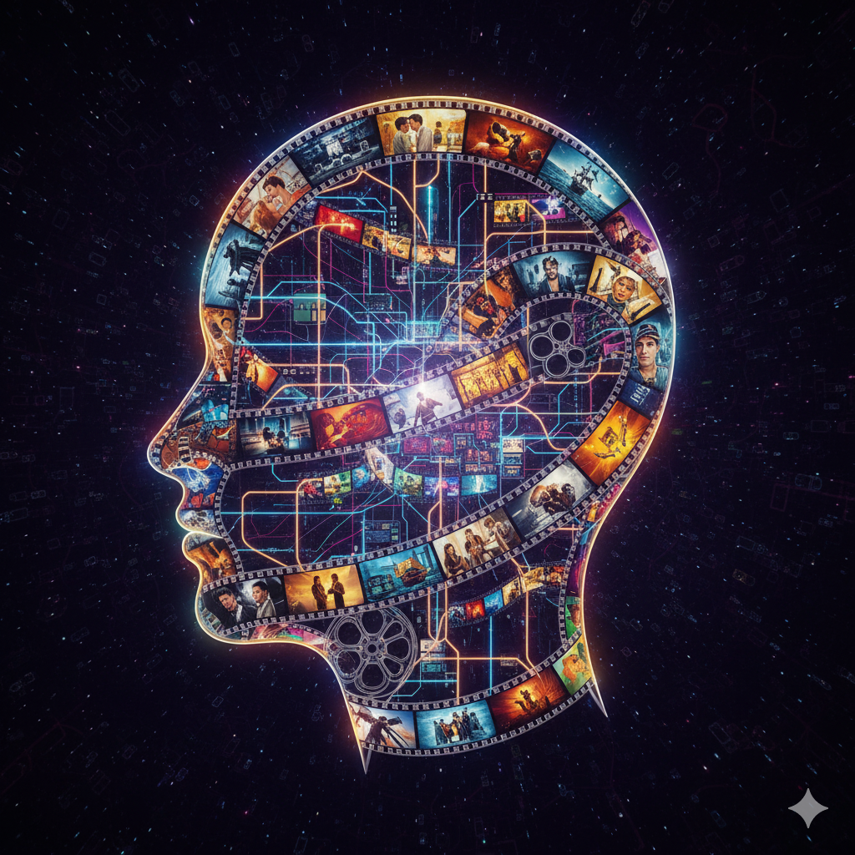
🌱 Sustainability in AI Systems
EchoReel optimizes for lightweight, sustainable computation:
Uses CountVectorizer over heavy neural models for speed and energy efficiency
Cached similarity matrices reduce redundant computation
Compact Pickle model = lower memory footprint and greener AI processing

Slide 15
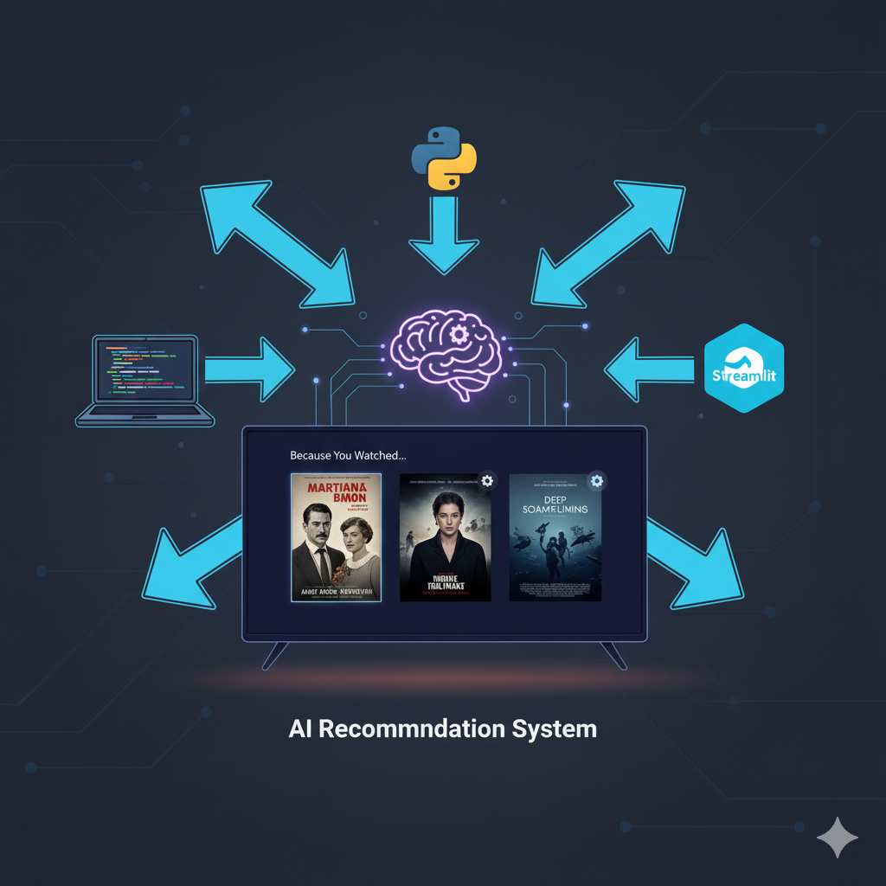
🚀 The Road Ahead
EchoReel is just the beginning of smarter, context-aware entertainment discovery.
Future Enhancements:
🔹 Integrate hybrid filtering (content + user behavior) 🔹 Use BERT embeddings for semantic-level movie understanding 🔹 Add visual similarity (poster-based CNN models) 🔹 Deploy on cloud (AWS / Hugging Face Spaces) for global access

Slide 16
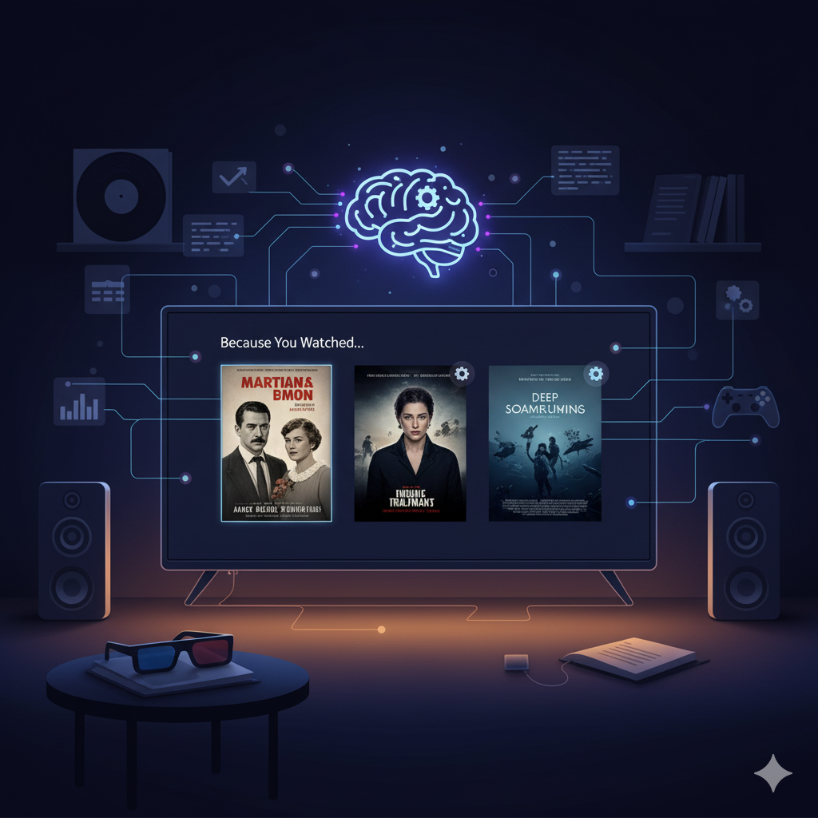
💡 Conclusion: Empowering Stories Through AI
EchoReel bridges technology and storytelling — helping users find the right movie at the right time.
By combining AI precision with human curiosity, it redefines entertainment discovery for the modern era.
🎬 “Because sometimes, the best story is the one you didn’t know you needed to see.”

Slide 17
THANKYOU

